Slide 1
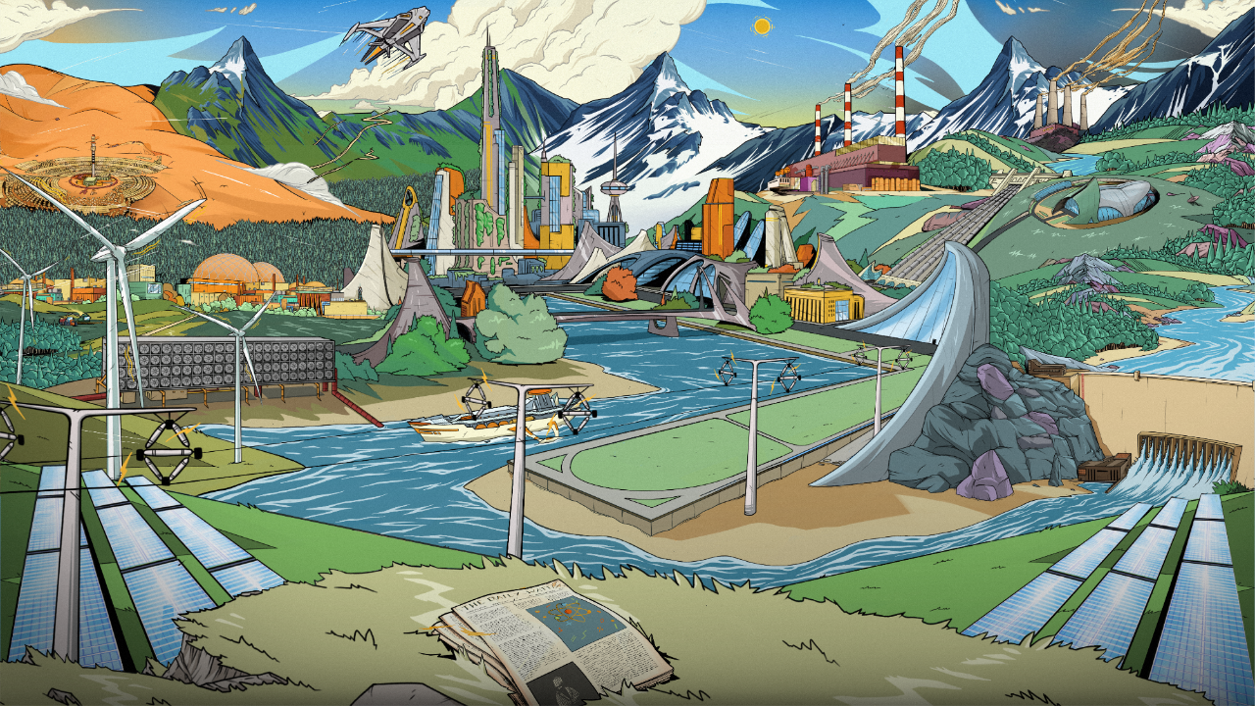
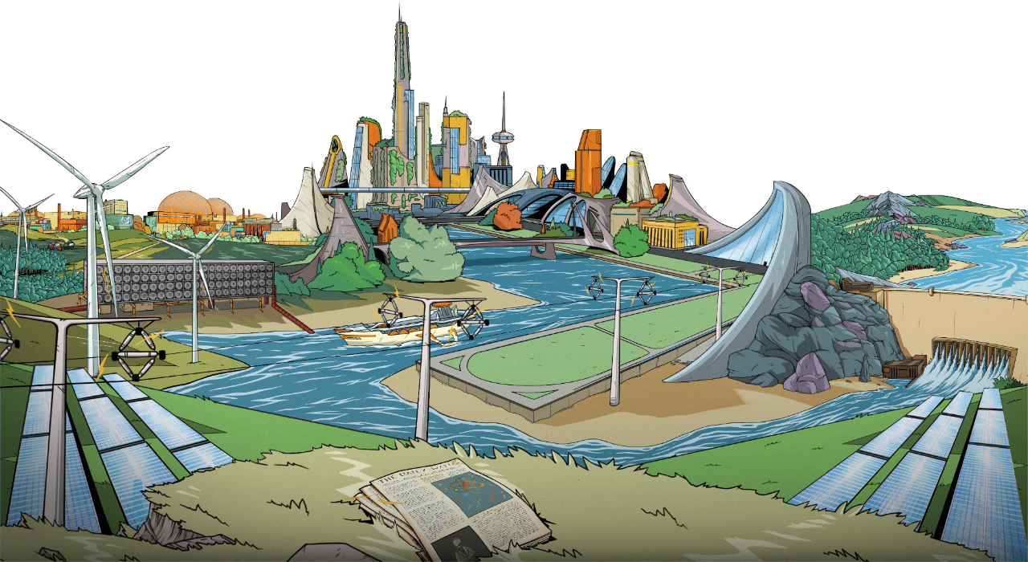

Slide 2
Playing Megawatt
Structuring a 60-minute lesson
Playing Megawatt
Scoring and Discussion
Feedback and Tidy
Set up
Intro
Build Phase
Event Phase
0 min
5 min
10 min
20 min
45 min
55 min

Slide 3
Playing Megawatt
Set up (0-5 minutes)
Arrange the room
3-5 per table
Up to 8 tables
Facing one another
Distribute
Megawatt
1 per table
Set up projector
Load the instructional slides
Notes:
Arrange students into separate tables, 3 to 5 per table, maximum 8 tables
Ideally facing each other around the table (but can turn to look at projector)
Keeping tables separate prevents decks being mixed together
Place one Megawatt deck on each table
Students may open the box
There is an instructional leaflet and 5 quick rule cards
Get the interactive instructions slides up on the projector

Slide 4
PLAYING MEGAWATT
Play Megawatt (5-45 minutes). Using the instructional slide pack:
Intro (5-10 minutes)
Introduce each card type
Set up the game
Build Phase (10 – 20 minutes)
Tech card overview
Build phase walkthrough
Playing the build phase
Event Phase (20 – 45 minutes)
Upgrades, Actions and Events
Event phase walkthrough
Playing the event phase
Notes:
Play around with the slides before the lesson – understand how they work.
Overview of the slides:
Introduction to Megawatt
Encourage students to look at the cards when discussing each one
Younger classrooms may struggle to shuffle the cards properly so make sure they're shuffled beforehand
Build Phase
Start with Tech cards and show the stats
Go through the rest of the slides until the home button appears
Get students to play the build phase
Youngest player starts
Play moves clockwise one player at time
Two rounds
Event Phase
Start with Upgrade, Action and Event cards and show the stats
Go through the rest of the slides until the home button appears
Get students to play the event phase
Play moves clockwise one player at time
Seven rounds (or until time runs out)
Scoring
Show the Scoring slide
Help students score their grids
Gameplay
Not recommended to use in a classroom
Works as an appendix to help you understand how a game flows

Slide 5
Playing Megawatt
Scoring and Discussion (45-55 minutes)
When there are 20 minutes left ask students to finish the current round
Show and explain the scoring slide
Score the grids
Each table will have played a different number of rounds so try not to compare scores between tables
Discuss the grids and ask students questions

Slide 6
Playing Megawatt
Example discussion points
What helped the winner get the best score?
What Event cards came up that helped or hindered your grid?
Did you change your strategy as the game went on?
What would you do differently next time?

Slide 7
Playing Megawatt
Feedback and tidy away
Gather some quick feedback from the class with a show of hands
Who enjoyed playing Megawatt?
Who learned something new about energy?
Who is considering a career in energy?
Who would want to play again?
Tidy away
Collect all Megawatt decks and any stray cards
Notes:
Take notes on how the lesson went and how many students raised their hands – this will help to complete the feedback form.

Slide 8
Feedback
Once you have completed the activity, please take 5 minutes to complete this feedback form: https://forms.office.com/r/buKq3bZZS1

